Slide 1
Lecture 5
Co-integration, Error Correction Models

Slide 2
Chapter Contents
12.4 Cointegration
12.5 Regression When There Is No Cointegration

Slide 3
12.4
Cointegration

Slide 4
12.4
Cointegration
As a general rule, nonstationary time-series variables should not be used in regression models to avoid the problem of spurious regression
There is an exception to this rule

Slide 5
12.4
Cointegration
There is an important case when e_{t} = y_{t} - β₁ - β₂x_{t} is a stationary I(0) process
In this case y_{t} and x_{t} are said to be cointegrated
Cointegration implies that y_{t} and x_{t} share similar stochastic trends, and, since the difference e_{t} is stationary, they never diverge too far from each other

Slide 6

12.4
Cointegration
The test for stationarity of the residuals is based on the test equation:
The regression has no constant term because the mean of the regression residuals is zero.
We are basing this test upon estimated values of the residuals
Eq. 12.7
$$Δ{\hat{e}}_{t}=γ{\hat{e}}_{t−1}+v_{t}$$

Slide 7
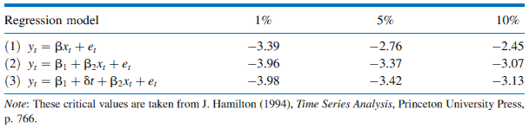
12.4
Cointegration
Table 12.4 Critical Values for the Cointegration Test

Slide 8



12.4
Cointegration
There are three sets of critical values
Which set we use depends on whether the residuals are derived from:
Eq. 12.8a
$$Equation 1:{ } {\hat{e}}_{t}=y_{t}−b​x_{t}$$
Eq. 12.8b
$$Equation 2:{ } {\hat{e}}_{t}=y_{t}−b_{2}x_{t}−b_{1}$$
Eq. 12.8c
$$Equation 3:{ } {\hat{e}}_{t}=y_{t}−b_{2}x_{t}−b_{1}−\hat{δ}t$$

Slide 9
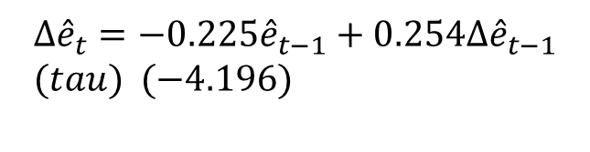
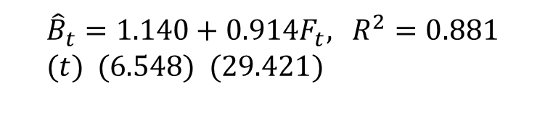
12.4
Cointegration
12.4.1
An Example of a Cointegration Test
Consider the estimated model:
The unit root test for stationarity in the estimated residuals is:
$${\hat{B}}_{t}=1.140+0.914F_{t}\text{, }R^{2}=0.881 \\ (t) (\text{6.548}) (\text{29.421})$$
Eq. 12.9
$$Δ{\hat{e}}_{t}=−0.225{\hat{e}}_{t−1}+0.254Δ{\hat{e}}_{t−1} \\ (tau) (−4.196)$$

Slide 10
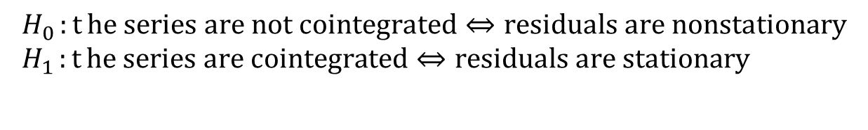
12.4
Cointegration
12.4.1
An Example of a Cointegration Test
The null and alternative hypotheses in the test for cointegration are:
Similar to the one-tail unit root tests, we reject the null hypothesis of no cointegration if τ ≤ τ_{c}, and we do not reject the null hypothesis that the series are not cointegrated if τ > τ_{c}
$$H_{0}:{t}\text{he} \text{series} \text{are} \text{not} \text{cointegrated}⇔\text{residuals} \text{are} \text{nonstationary} \\ H_{1}:{t}\text{he} \text{series} \text{are} \text{cointegrated}⇔\text{residuals} \text{are} \text{stationary}$$

Slide 11

12.4
Cointegration
12.4.2
The Error Correction Model
Consider a general model that contains lags of y and x
Namely, the autoregressive distributed lag (ARDL) model, except the variables are nonstationary:
$$y_{t}=δ+θ_{1}y_{t−1}+δ_{0}x_{t}+δ_{1}x_{t−1}+v_{t}$$

Slide 12


12.4
Cointegration
12.4.2
The Error Correction Model
If y and x are cointegrated, it means that there is a long-run relationship between them
To derive this exact relationship, we set y_{t} = y_{t-1} = y, x_{t} = x_{t-1} = x and v_{t} = 0
Imposing this concept in the ARDL, we obtain:
This can be rewritten in the form:
$$y\left(1−θ_{1}\right)=δ+\left(δ_{0}+δ_{1}\right)x$$
$$y=β_{1}+β_{2}x$$

Slide 13
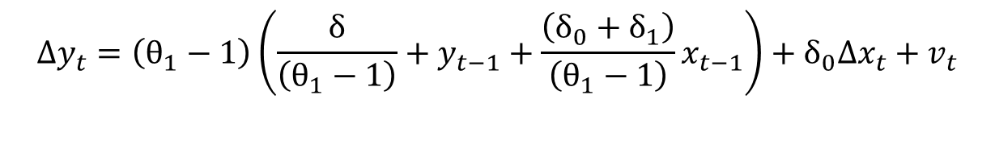
12.4
Cointegration
12.4.2
The Error Correction Model
Add the term -y_{t-1} to both sides of the equation:
Add the term – δ₀x_{t-1}+ δ₀x_{t-1}:
Manipulating this we get:
$$y_{t}−y_{t−1}=δ+\left(θ_{1}−1\right)y_{t−1}+δ_{0}x_{t}+δ_{1}x_{t−1}+v_{t}$$
$$Δy_{t}=δ+\left(θ_{1}−1\right)y_{t−1}+δ_{0}\left(x_{t}−x_{t−1}\right)+\left(δ_{0}+δ_{1}\right)x_{t−1}+v_{t}$$
$$Δy_{t}=\left(θ_{1}−1\right)\left(\frac{δ}{\left(θ_{1}−1\right)}+y_{t−1}+\frac{\left(δ_{0}+δ_{1}\right)}{\left(θ_{1}−1\right)}x_{t−1}\right)+δ_{0}Δx_{t}+v_{t}$$

Slide 14

12.4
Cointegration
12.4.2
The Error Correction Model
Or:
This is called an error correction equation
This is a very popular model because:
It allows for an underlying or fundamental link between variables (the long-run relationship)
It allows for short-run adjustments (i.e. changes) between variables, including adjustments to achieve the cointegrating relationship
Eq. 12.10
$$Δy_{t}=−α\left(y_{t−1}−β_{1}−β_{2}x_{t−1}\right)+δ_{0}Δx_{t}+v_{t}$$

Slide 15

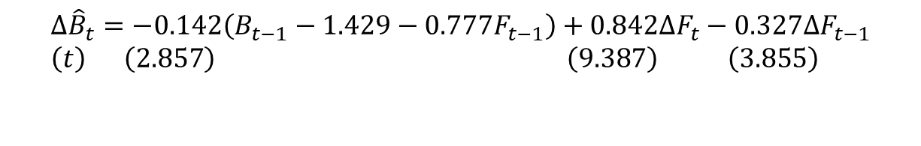
12.4
Cointegration
12.4.2
The Error Correction Model
For the bond and federal funds rates example, we have:
The estimated residuals are
$$Δ{\hat{B}}_{t}=−\text{0.142}\left(B_{t−1}−1.429−0.777F_{t−1}\right)+0.842ΔF_{t}−0.327ΔF_{t−1} \\ \left(t\right) \left(2.857\right) \left(9.387\right) \left(3.855\right)$$
$${\hat{e}}_{t−1}=\left(B_{t−1}−1.429−0.777F_{t−1}\right)$$

Slide 16
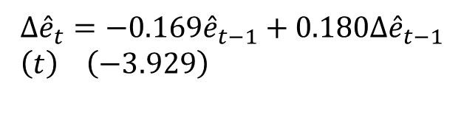
12.4
Cointegration
The result from applying the ADF test for stationarity is:
Comparing the calculated value (-3.929) with the critical value, we reject the null hypothesis and conclude that (B, F) are cointegrated
$$Δ{\hat{e}}_{t}=−\text{0.169}{\hat{e}}_{t−1}+0.180Δ{\hat{e}}_{t−1} \\ \left(t\right) \left(−3.929\right)$$

Slide 17
12.5
Regression with No-Cointegration

Slide 18
12.5
Regression When There is No Cointegration
How we convert nonstationary series to stationary series, and the kind of model we estimate, depend on whether the variables are difference stationary or trend stationary
In the former case, we convert the nonstationary series to its stationary counterpart by taking first differences
In the latter case, we convert the nonstationary series to its stationary counterpart by de-trending

Slide 19


12.5
Regression When There is No Cointegration
12.5.1
First Difference Stationary
Consider the random walk model:
This can be rendered stationary by taking the first difference:
The variable y_{t} is said to be a first difference stationary series
$$y_{t}=y_{t−1}+v_{t}$$
$$Δy_{t}=y_{t}−y_{t−1}=v_{t}$$

Slide 20



12.5
Regression When There is No Cointegration
12.5.1
First Difference Stationary
A suitable regression involving only stationary variables is:
Now consider a series y_{t} that behaves like a random walk with drift:
with first difference:
The variable y_{t} is also said to be a first difference stationary series, even though it is stationary around a constant term
Eq. 12.11a
$$Δy_{t}=θΔy_{t−1}+β_{0}Δx_{t}+β_{1}Δx_{t−1}+e_{t}$$
$$y_{t}=α+y_{t−1}+v_{t}$$
$$Δy_{t}=α+v_{t}$$

Slide 21
12.5
Regression When There is No Cointegration
12.5.1
First Difference Stationary
Suppose that y and x are I(1) and not cointegrated
An example of a suitable regression equation is:
Eq. 12.11b
$$Δy_{t}=α+θΔy_{t−1}+β_{0}Δx_{t}+β_{1}Δx_{t−1}+e_{t}$$

Slide 22


12.5
Regression When There is No Cointegration
12.5.2
Trend Stationary
Consider a model with a constant term, a trend term, and a stationary error term:
The variable y_{t} is said to be trend stationary because it can be made stationary by removing the effect of the deterministic (constant and trend) components:
$$y_{t}=α+δt+v_{t}$$
$$y_{t}−α−δt=v_{t}$$

Slide 23

12.5
Regression When There is No Cointegration
12.5.2
Trend Stationary
If y and x are two trend-stationary variables, a possible autoregressive distributed lag model is:
Eq. 12.12
$$y_{t}^{∗}=θ​y_{t−1}^{∗}+β_{0}x_{t}^{∗}+β_{1}x_{t−1}^{∗}+e_{t}$$

Slide 24

12.5
Regression When There is No Cointegration
12.5.2
Trend Stationary
As an alternative to using the de-trended data for estimation, a constant term and a trend term can be included directly in the equation:
where:
$$y_{t}=α+δt+θ​y_{t−1}+β_{0}x_{t}+β_{1}x_{t−1}+e_{t}$$
$$α=α_{1}(1−θ_{1})−α_{2}(β_{0}+β_{1})+θ_{1}δ_{1}+β_{1}δ_{2}$$
$$δ=δ_{1}(1−θ_{1})−δ_{2}(β_{0}+β_{1})$$

Slide 25
12.5
Regression When There is No Cointegration
12.5.3
Summary
If variables are stationary, or I(1) and cointegrated, we can estimate a regression relationship between the levels of those variables without fear of encountering a spurious regression
If the variables are I(1) and not cointegrated, we need to estimate a relationship in first differences, with or without the constant term
If they are trend stationary, we can either de-trend the series first and then perform regression analysis with the stationary (de-trended) variables or, alternatively, estimate a regression relationship that includes a trend variable

Slide 26
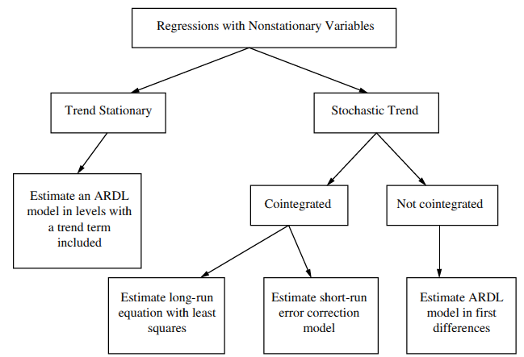
12.5
Regression When There is No Cointegration
FIGURE 12.4 Regression with time-series data: nonstationary variables
12.5.3
Summary

